Slide 1
Presentation on Implementation and Evaluation of SOFTWARE QUALITY ASSURANCE
Presented by: MD DELwar Hossain mojumder
Id:2021000010022
Batch: 10 (CSE)
Southeast University
05 july 2025

Slide 2
Internship Overview:
Practical experience in SQA (Software Quality Assurance) at Dream71 Bangladesh Ltd.
Key Learning Areas:
Website testing techniques and tools.
Project management in SDLC (Software Development Life Cycle.

Slide 3

SOFTWARE Quality Assurance (SQA)
Definition: Ensuring software meets defined quality standards through planned and systematic activities.
Key Practices:
Test planning, Defect tracking, and Process audits.
Tools like Postman, JMeter, and Trello.

Slide 4
Project Management Overview
Role in SDLC: Initiation, planning, execution, monitoring and closure.
Key Tools and Techniques:
Agile and scrum methodologies.
Tools like Jira, Trello, TestRail.

Slide 5
Internship Projects Overview
Projects Worked On:
Re-designing, Management and Maintenance of IT infrastructure and Online System of NGOAB Collaborated with UNDP and NGOAB by ISPAT project.
DLS (Department of Livestock Services) License Management System (Category-2 License).
Department of Shipping (DoS) – Inland Crew Certification Management System.
Intelligent Land Knowledge Management System (iLKMS) – Ministry of Land.
Educational Game for the Ministry of Education Timor-Leste.

Slide 6
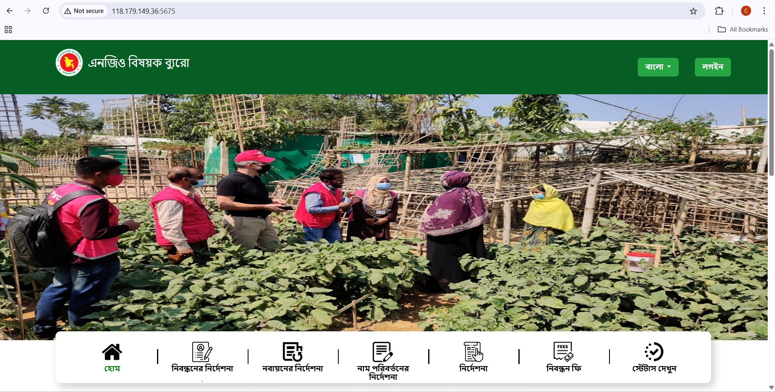
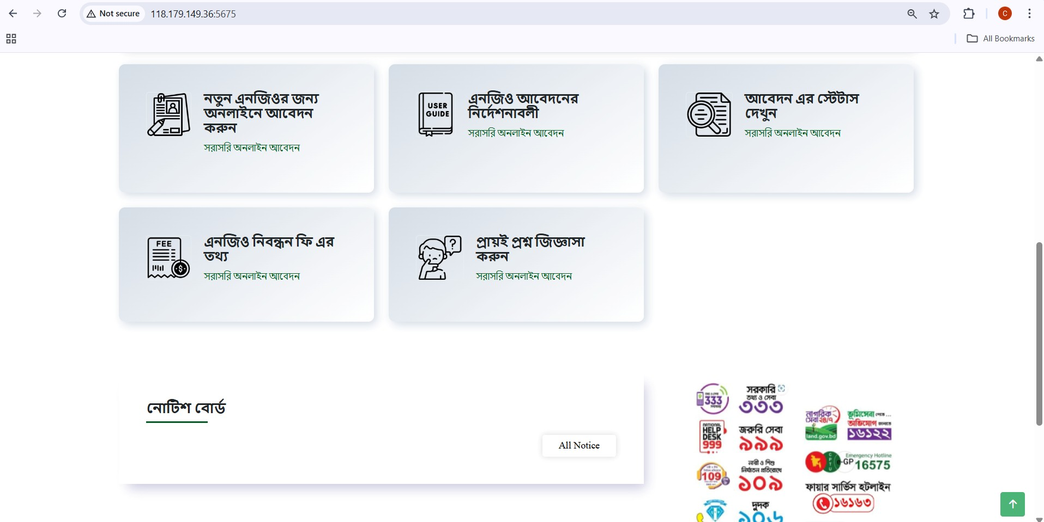
Projects Overview
Projects Worked On:
Re-designing, Management and Maintenance of IT infrastructure and Online System of NGOAB, Collaborated with UNDP and NGOAB by the ISPAT project.

Slide 7
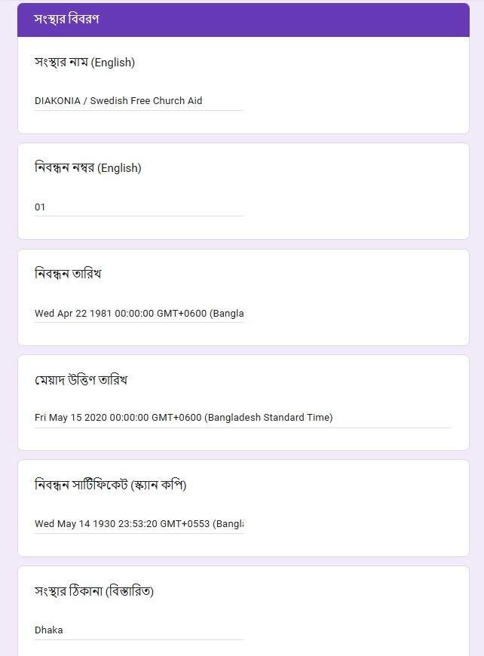
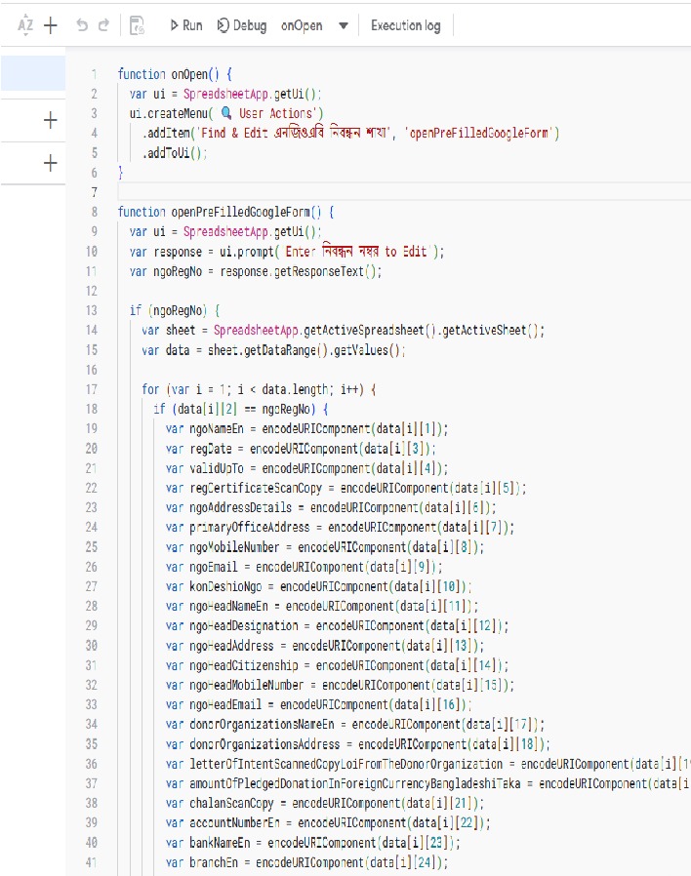
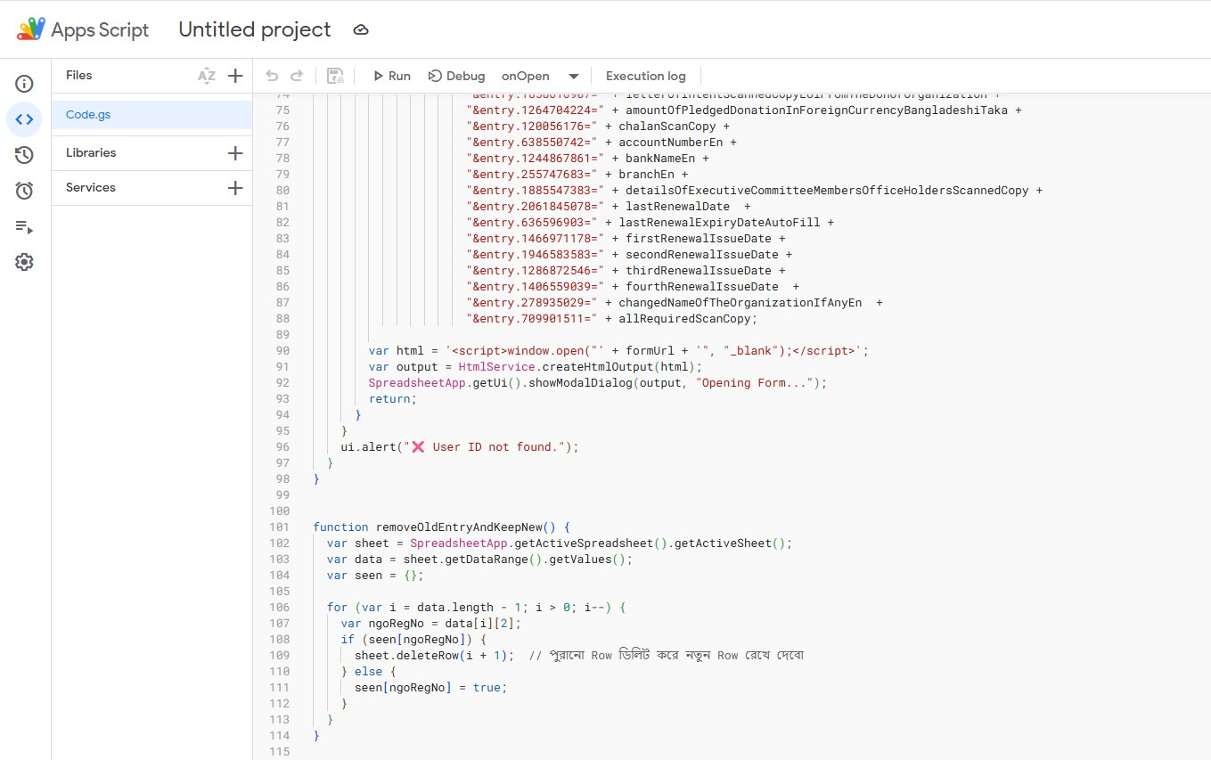
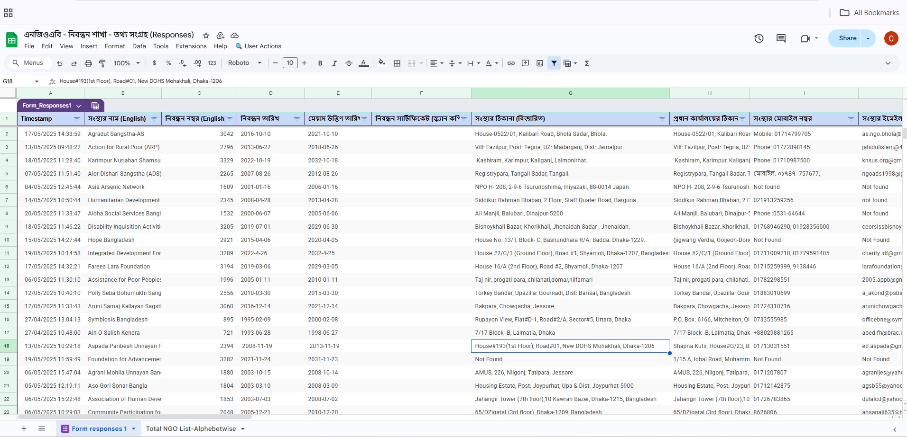
Projects Overview

Slide 8
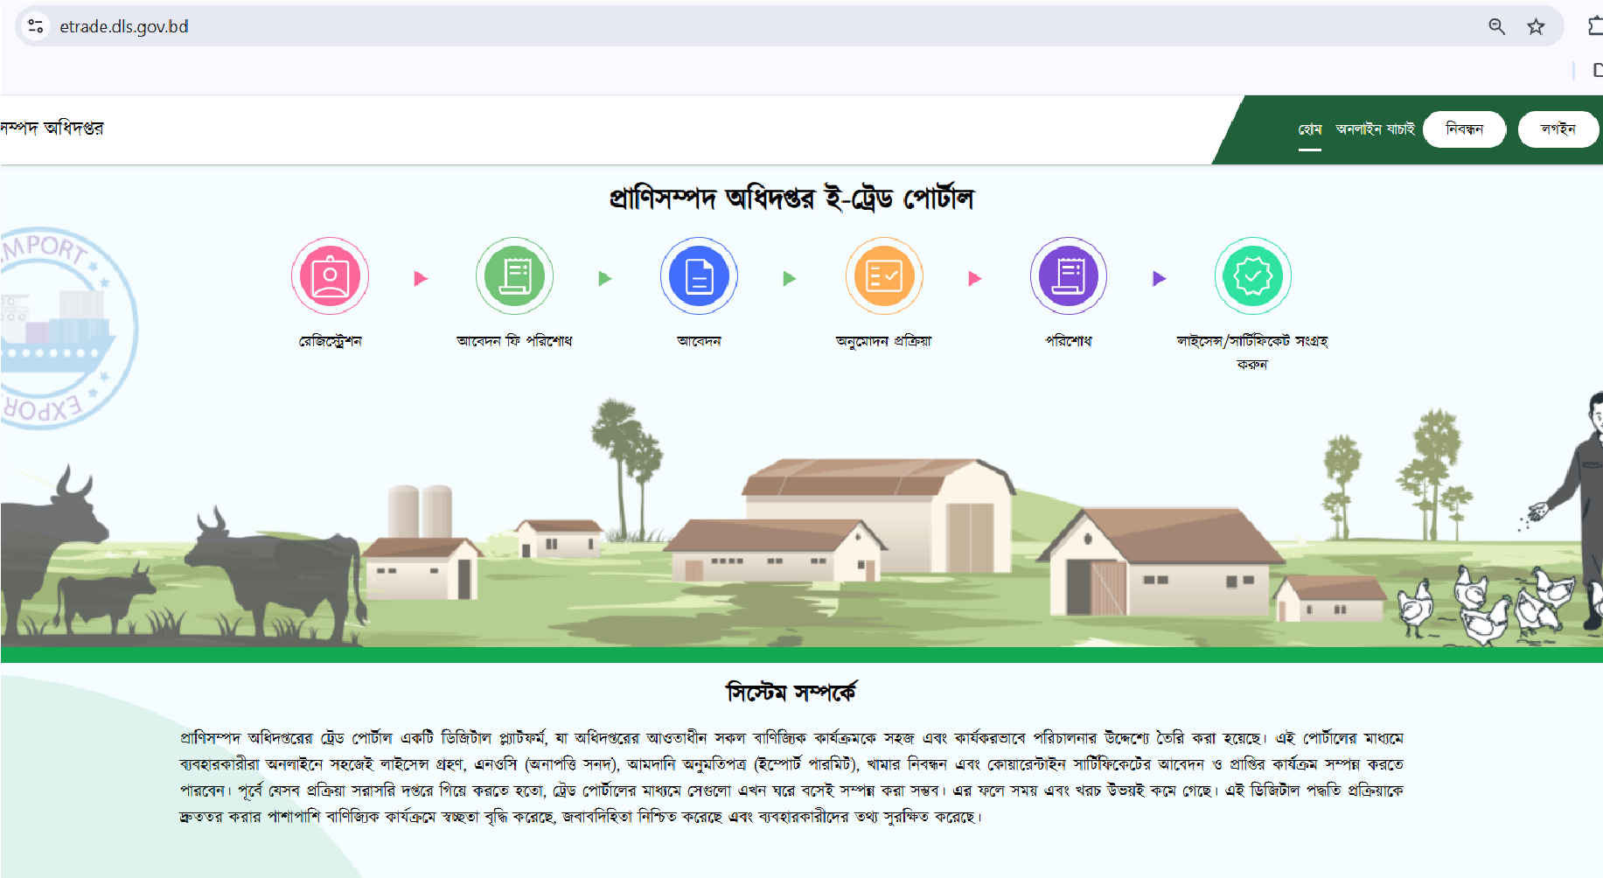
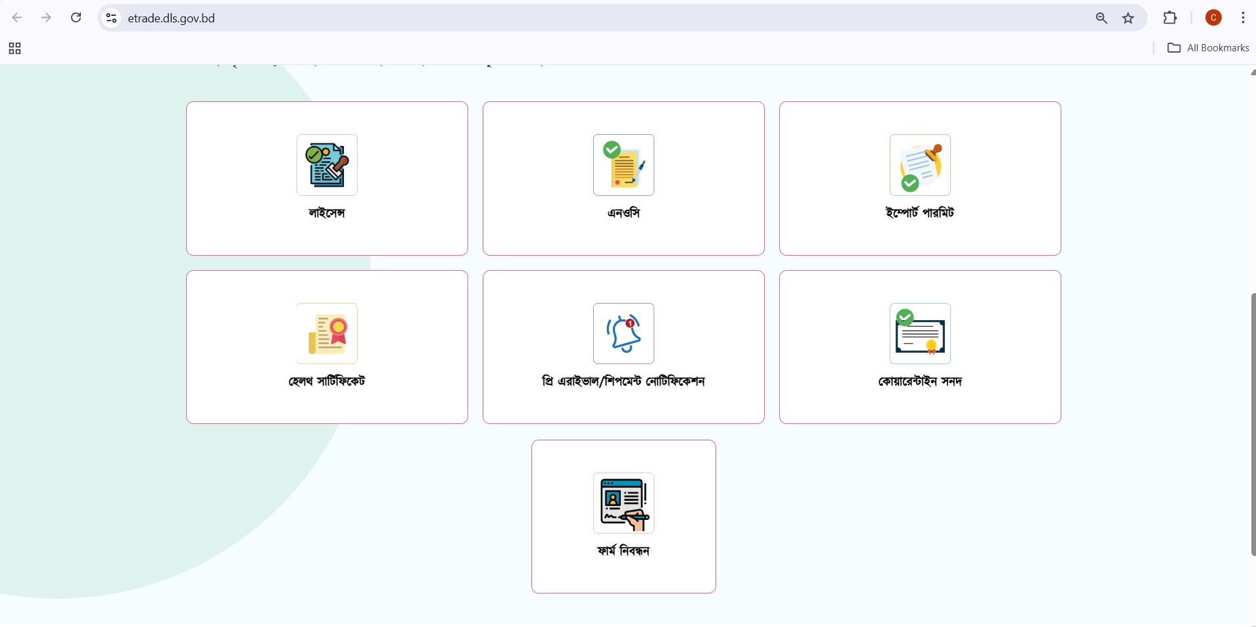
Projects Overview
Projects Worked On:
Department of Livestock Services (DLS) – Category-2 License Management System.

Slide 9
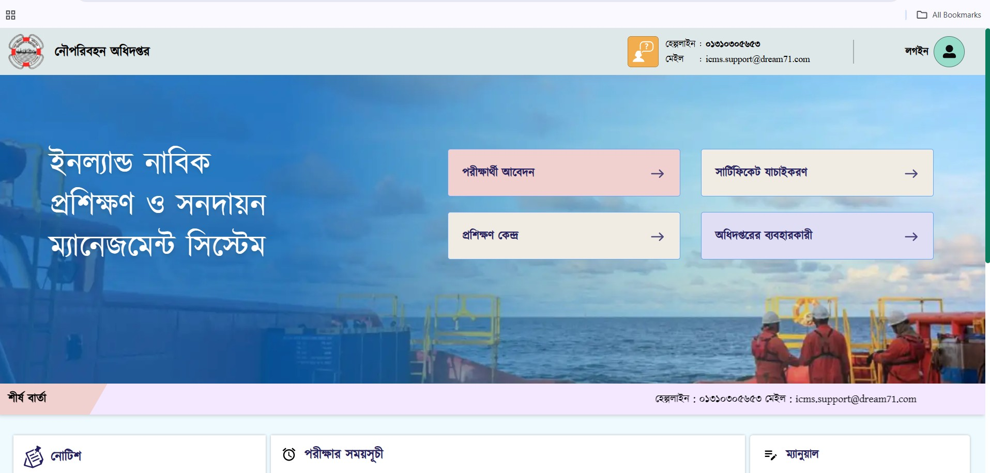
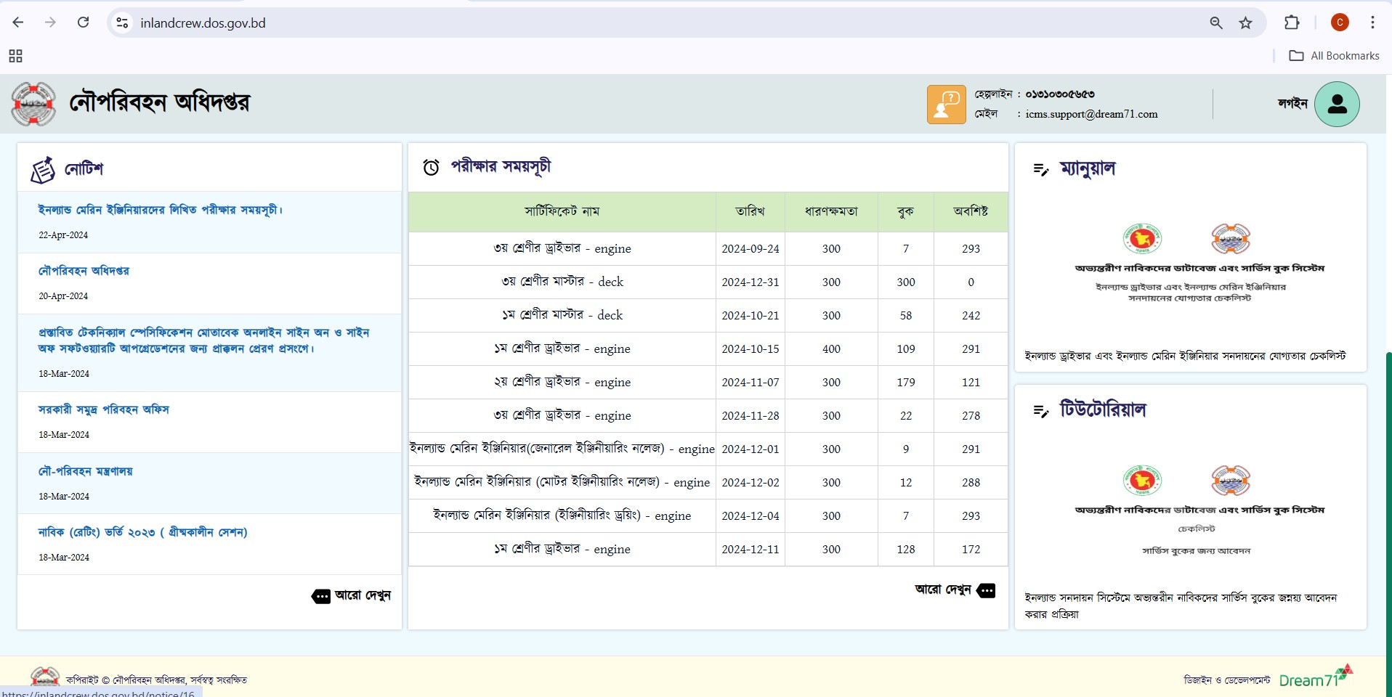
Projects Overview
Projects Worked On:
Department of Shipping (DoS) – Inland Crew Certification Management System.

Slide 10
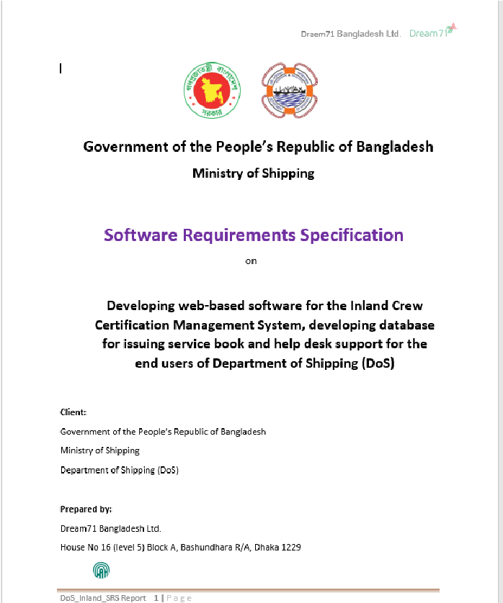
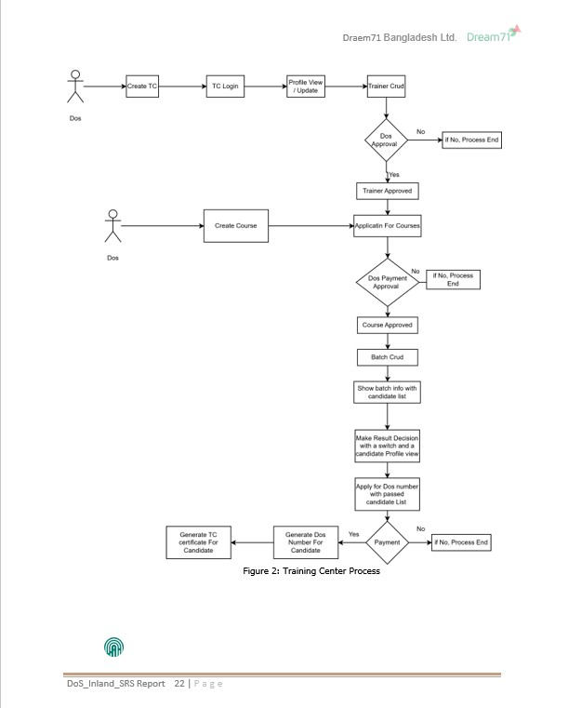
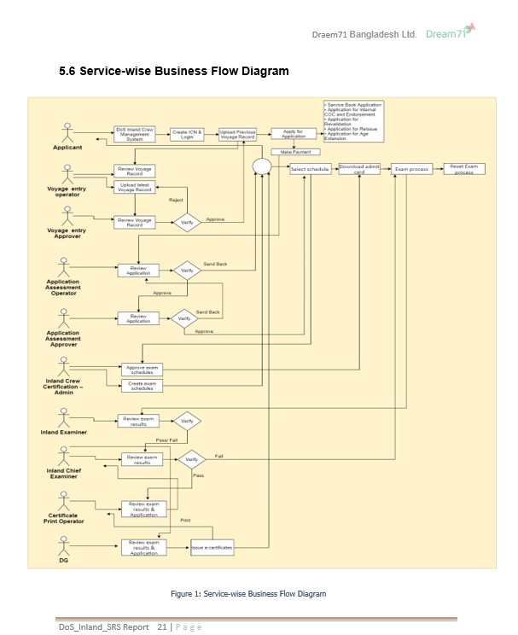
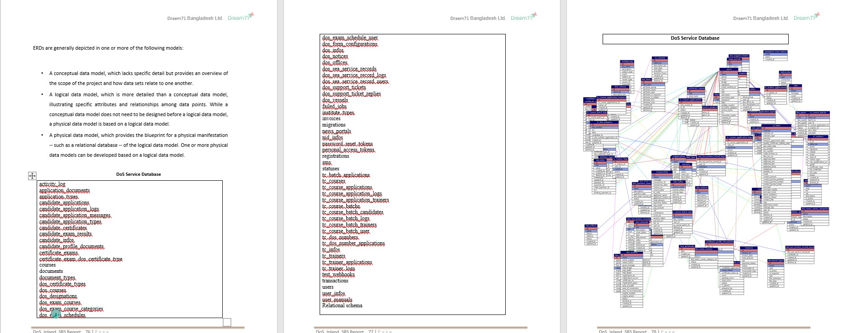
Projects Overview

Slide 11
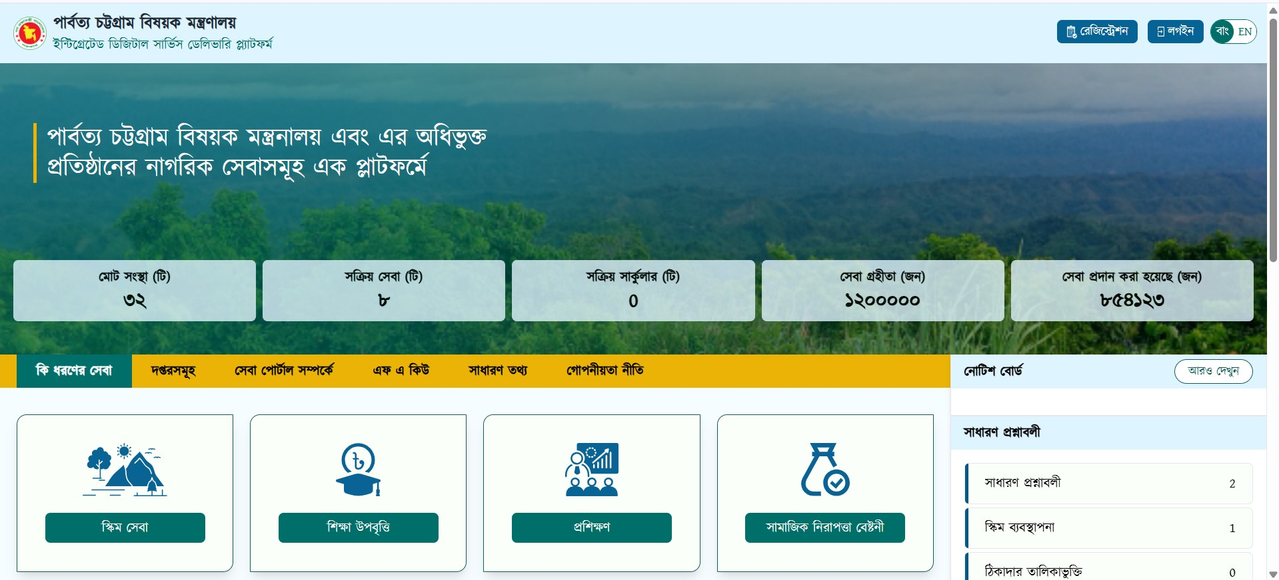
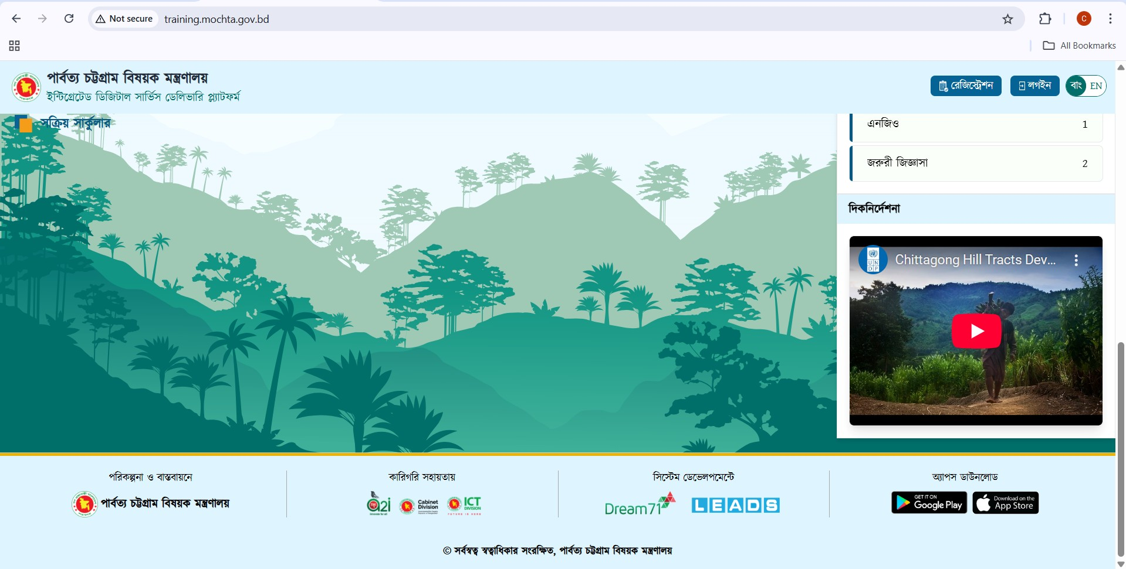
Projects Overview
Projects Worked On:
Intelligent Land Knowledge Management System (iLKMS) – Ministry of Land.

Slide 12
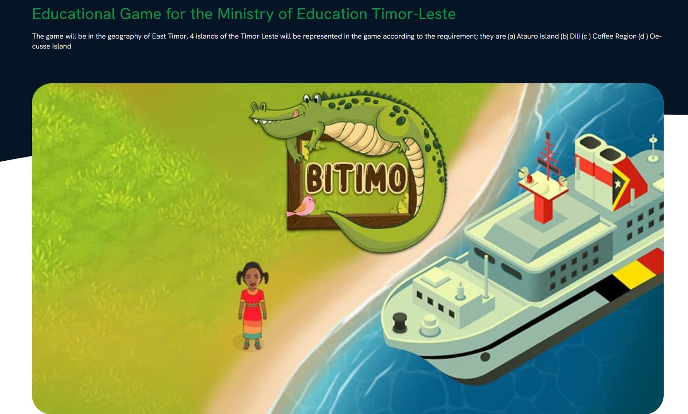
Projects Overview
Projects Worked On:
Educational Game for the Ministry of Education Timor-Leste.

Slide 13
Learning Outcomes
Technical Skills:
Manual and automated testing.
Use of SQA and project management tools.
Project Management Skills:
Agile and Scrum frameworks.
Resource and timeline management.

Slide 14
Conclusion and Future Goals
Conclusion:
Gained hands-on experience in SQA (Software Quality Assurance).
Acquired skills essential for the software industry.
Future Goals:
Further skill development in advanced testing tools and methodologies.
Continuing education in Agile project management.

Slide 15
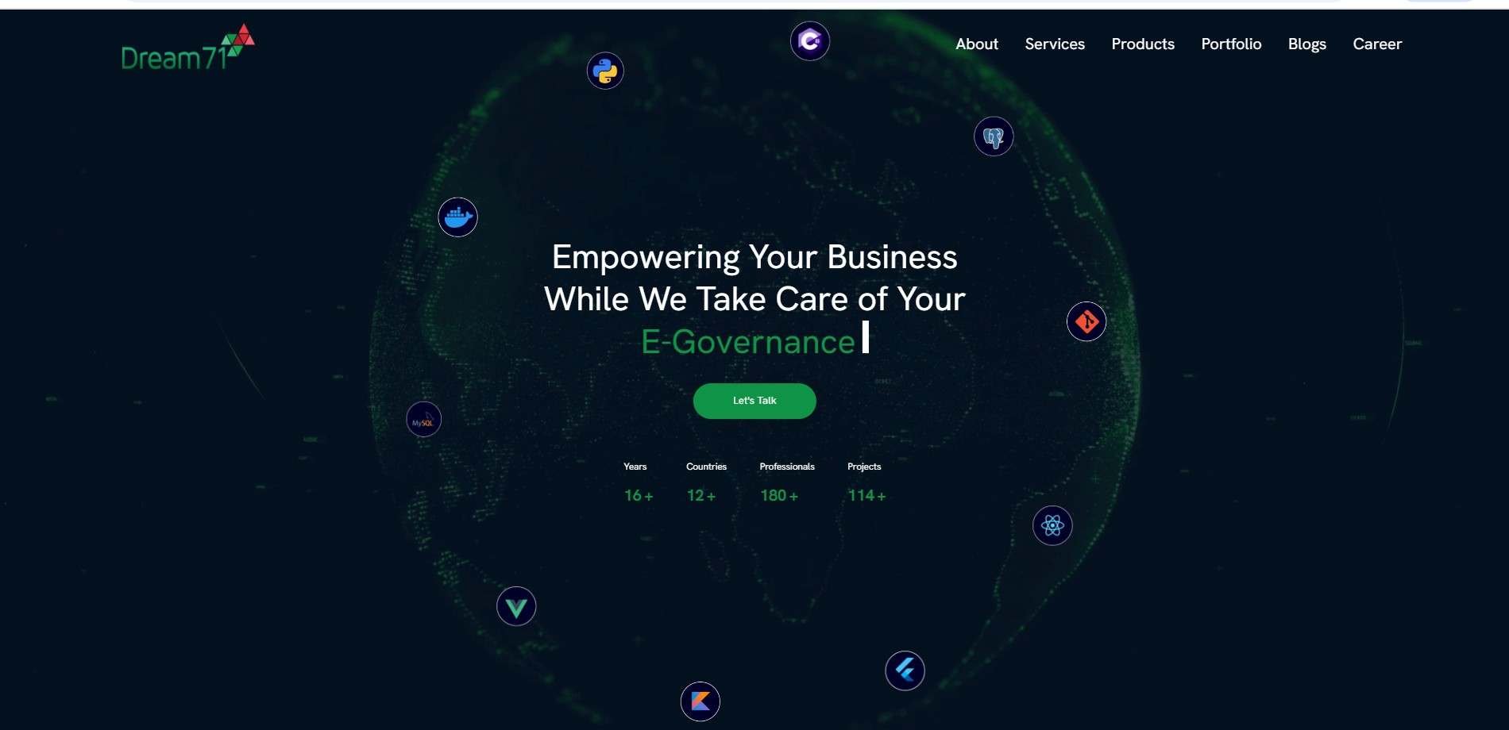
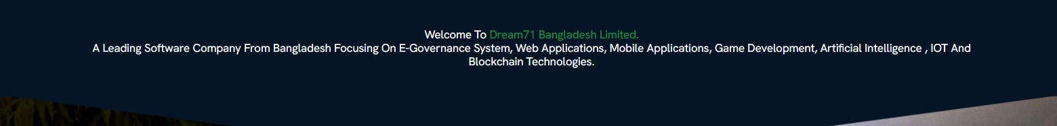
Company Details
Email ID: info@dream71.com
Mobile: +8801715091734
Web: https://www.dream71.com
Address: House No 16 ( Level 5 and 9) Block - A, Basundhara R/A, Main Road, Dhaka-1229,Bangladesh.

Slide 16
Acknowledgments
Special Thanks to:
Mentors at Dream71 Bangladesh Ltd.
University supervisors and professors.

